Slide 1
Chapter 10: Dynamic Programming
DP is another class of problem-solving approaches like Greedy algorithms and Divide-and-conquer
  Unfortunately, DP is a misleading name
    “dynamic” is not meant to convey that the algorithm adapts dynamically to the situation (as is needed in many Artificial Intelligence and real-time problems)
    but instead, dynamic conveys that the solution consists of a series of choices where the choices depend on the current state of the problem (that is, the choices, or the value of a given choice, changes over time)
DP is often used to solve optimization problems and will improve on solutions over greedy algorithms
  DP may also improve on the computational complexity of an algorithm over divide-and-conquer

Slide 2
What is DP?
Divide-and-conquer uses recursion
  to make a problem easier to solve by breaking it into smaller problems in a top-down fashion
DP also uses recursion (or it may use iteration if more desired)
  to take a problem, break it down into small problems, but instead of a top-down approach, uses a bottom-up approach
  the small solutions are used to solve a bigger problem which are combined to solve a bigger problem etc…
    In fact the idea behind DP is essentially to remember what you have done previously in solving a smaller problem and apply that knowledge to the bigger problem
    We will use a dictionary ADT to remember the solutions to the smaller problems

Slide 3
Example: Fibonacci
You might recall from 262 or 364 a simple recursive-based solution to Fibonacci
  Also recall that computing the n^{th} Fibonacci value is θ(n) if done iteratively
Our recursive solution has a recurrence equation
  T(n) = T(n-1) + T(n-2) + 1 where T(1) and T(0) = 0
    T(n) ≈ 2 * T(n-2) + 1
  From equation 3.12 (chapter 3), this tells us that T(n) = 2^{n/2} which is θ(2^{n})
Why should the recursive solution be so much more time consuming than the iterative one?
  Because of a lot of repetition
    For instance, to compute F(6) we must call F(5) and F(4) but F(5) also calls F(4), so we wind up calling F(4) twice, but we call F(3) 3 times
      once for F(5), once for each of the two calls to F(4)

Slide 4
Improving Fibonacci
The key to improving our recursive version of Fibonacci is to notice
  the complexity is only poor because we do not remember the results
    in F(6), we wind up calling F(3) several times
  but if we had remembered the value of F(3) after the first time, we won’t need to call it again, merely recall the value from storage
  so, we add a dictionary whereby we store every fib(n) in f (our dictionary) and check to see if f(n-1) or f(n-2) are already stored before recursively calling fib(n-1) or fib(n-2)
    code given to the right
fib(f, n)
if(n<2)
store(f, n, 1);
return 1;
else
int f1, f2;
if(!member(f, n-1))
f1 = fib(f, n-1)
else
f1 = retrieve(f, n-1)
if(!member(f, n-2))
f2 = fib(f, n-2)
else
f2 = retrieve(f, n-2)
store(f, n, f1+f2)
return f1+f2
    This code has a recurrence equation
    of T(n) = T(n-1) + 1 which has a
    complexity in θ(n)

Slide 5
Traveling Salesman Problem
One of the most commonly cited problems in CS is the TSP which demonstrates why some problems are very hard to solve
  Given a network and a starting vertex, find a path that goes through every vertex and returns to the start such that it has the minimum total path cost
  An exhaustive search will generate every possible path from start back to start and compare each to find the best solution
    There are (n-1)! possible paths if the network is complete making this solution θ(n!) > θ(2^{n}) so is a ridiculously hard problem
      consider solving this problem for a real salesman whose job it is to visit 20 cities and return, since nearly every city will have a route to every other city, this could require as much as 2*10¹⁸ comparisons, which could take our fastest supercomputer at least 23 days to solve and an ordinary computer hundreds of years!

Slide 6
Example
To demonstrate, consider a simple 5-node, complete graph
  Starting at vertex A, we have 4 choices (A-B, A-C, A-D, A-E)
  From each of these, we will have reached 2 vertices, so there are three possible choices
    From (A-B), we can get to C, D or E, from (A-C), we can get to B, D or E, etc
    So, to get to 3 vertices, there are a total of 4 * 3 or 12 choices
    After reaching the 3rd vertex, there are 2 left, so there will be a total of 4 * 3 * 2 choices to get from A to the 4th vertex
    There is a single vertex left followed by the edge home, so there are a total of 4 * 3 * 2 * 1 * 1 possible paths, or (5 – 1)!
A
B
C
D
E
If we add a 6th node,
F, then A has a 5th
choice, and from there,
there are 4 choices,
etc, so that the number of
paths is (n-1)!
If n is large, woe is us!

Slide 7
DFS Solution
min = infinity
path ← start
dfs (start, path, n, min)
dfs(current, path, n, min)
adj ← nodes adjacent to current
for each v in adj
if v is not already in path
path ← path + v
cost ← dfs(v, path, n, min)
+ weight(current, n)
if(cost < min)
bestPath = path
min = cost
We use the depth-first search strategy to generate every possible path from start
See the algorithm on the right
The complexity, as noted previously, is θ(n!)
If you envision a tree starting at the start node with its children being all of the nodes adjacent to start, and then each of their children being all of the nodes adjacent to themselves, etc, we have a graph that the DFS algorithm above will traverse with the proviso that a child that already appears in path will not be visited – this algorithm has (n-1)! nodes (at the most) and so the algorithm takes θ(n!)

Slide 8
A Better? Solution
Here we have a much simpler and more efficient algorithm
  A greedy version of TSP
  Does it solve the problem?
    No, we will not always wind up with the minimum path, so it cannot be said to solve TSP, which by definition, must determine the minimum cost path
    The graph below on the right is an example where this algorithm would not generate the minimum path – the minimum path (ABCD) costs 192, the one this algorithm generated (ABDC) costs 270!
path ← start
cost ← 0
while not all nodes yet in path
current = last node in path
adj ← nodes adjacent to current
that are not yet in path
v ← minimum[weight(current, adj₁),
weight(current, adj₂), …]
// that is, v is the node that has
// a minimum weight from
// current to v of all adjacent
// nodes note yet in the path
cost += weight(current, v)
path += v
10
11 81
90 80
90
A
B
This algorithm is θ(n²) but does not
properly solve the TSP so
C
D

Slide 9
The DP Solution to TSP
for(j=1;j<=n;j++)
minCost[j, *] = c[j, 0];
for(s=0;s<n-1;s++)
for(j=1;j<n;j++)
for each U in V – {j, 0} such that |U| = s
min ← infinity
for(k=1;k<n;k++)
if(k!=j)
sum = c[j,k] + minCost[k, U-{k}]
if(sum<min)
min = sum;
minV = k;
minCost[j, U] = min
path[j, U] = minV
min=C[1, 2] + minCost[2, V-{1, 2}]
for(j=3;j<=n;j++)
sum=C[1,j]+minCost[j, V-{1, j}]
if(sum<min)
min = sum;
minV = j;
In essence, the cost of a path is computed and built up in the minCost matrix that determines the minimum cost from j to k for all pairs of nodes
  The algorithm has a complexity of θ(n2^{n}) which is an improvement over θ(n!) but not a great improvement

Slide 10
Optimal Binary Trees for Search
Up until now, we have assumed that the best “shape” of a binary search tree is a height-balanced one
  so that our worst case add/search/delete is θ(log n)
However, what if we have additional information that tells us which nodes will most commonly be visited?
  In this case, it might be more worthwhile to make sure that those most sought after nodes are near the root of the tree
    even if it changes the shape of the tree away from being height balanced
So, a problem is, given nodes and their probabilities of being visited, what is the optimal tree?
  We want to find the tree that minimizes Σ_{i=0}^{n} (pr_{i}*c_{i})
    where pr_{i} is the probability of visiting node i
    and c_{i} is the cost of visiting node i (its depth in the tree)
  We will again use a DP algorithm to solve this problem

Slide 11
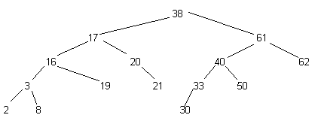
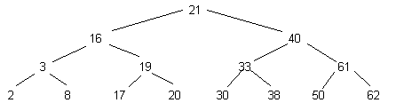
Example
Given the tree below on the left
  Imagine that we know that the most sought after nodes will be those storing 17, 38 and 61
  Unfortunately, those values are near or at the leaf level
    If 7 out of 10 searches pick those nodes with 3 out of 10 searches picking all other nodes equally, what is the cost?
      Since 17 and 38 are a depth (cost) of 3 and 61 is at a depth (cost) of 2, 7 out of 10 searches cost 3 or 4
      3 out of 10 searches (all others) cost between 0 and 3
      The average cost is then (7 / 3 * 3 + 7 / 3 * 3 + 7 / 3 * 2) / 10 + 3 / 10 * 2.2 (the average depth of the other 12 nodes) = 3.11 (the average cost is a search of 3.11)
    An improved tree is given below on the right with a cost of 1.34 for the average search!

Slide 12
Solving This Problem Using DFS
We want to minimize cost = Σ_{i=0}^{n} (pr_{i}*c_{i})
  Using a DFS strategy, we could generate all possible trees of n nodes given the array pr, compute the cost and the summation and pick the minimum one
  This solution would be θ(m) where m is the number of possible trees generated
    How many trees can be generated with n nodes? If we arbitrarily pick node j as the root, there are still n-1 nodes that could be selected as the root’s left child and n-2 for the root’s right child, and so forth as we build the tree top-down, so we would have (n-1)! trees for any given root node, so there are in fact n! possible trees
  So a DFS solution, which would be similar to the TSP version in terms of how it worked, would be θ(n!)
  Can we improve? Yes, through DP

Slide 13
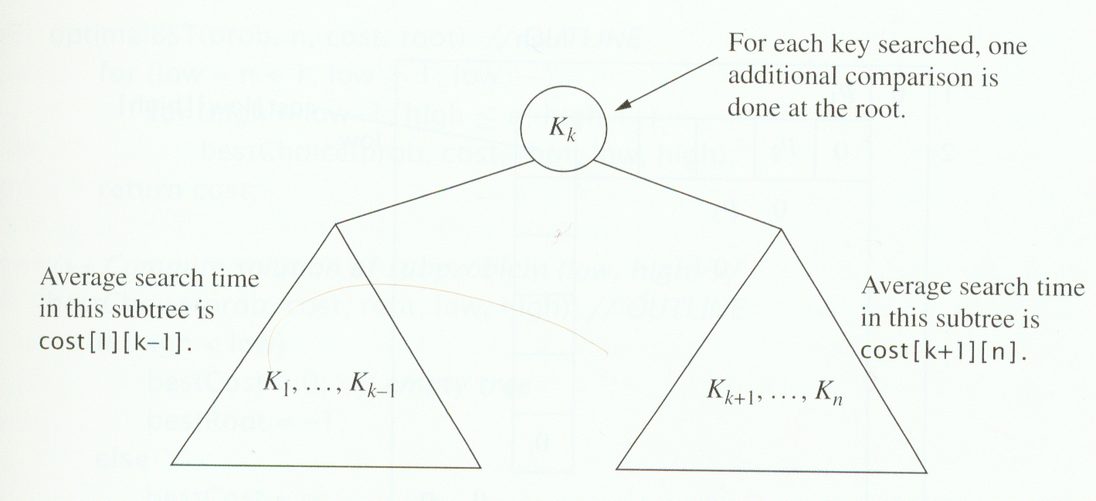
DP Strategy
Again, we will use a dictionary to remember information already processed
  We will store the minimum cost associated with a partial tree so that we can build the minimum tree from leaf level to root
  To solve our problem, we must compute Σ_{i=0}^{n} (pr_{i}*c_{i}) for every possible combination of tree
    We select a node to be root and generate the best left and best right subtrees, which may have already been generated and stored in the cost matrix (dictionary)

Slide 14
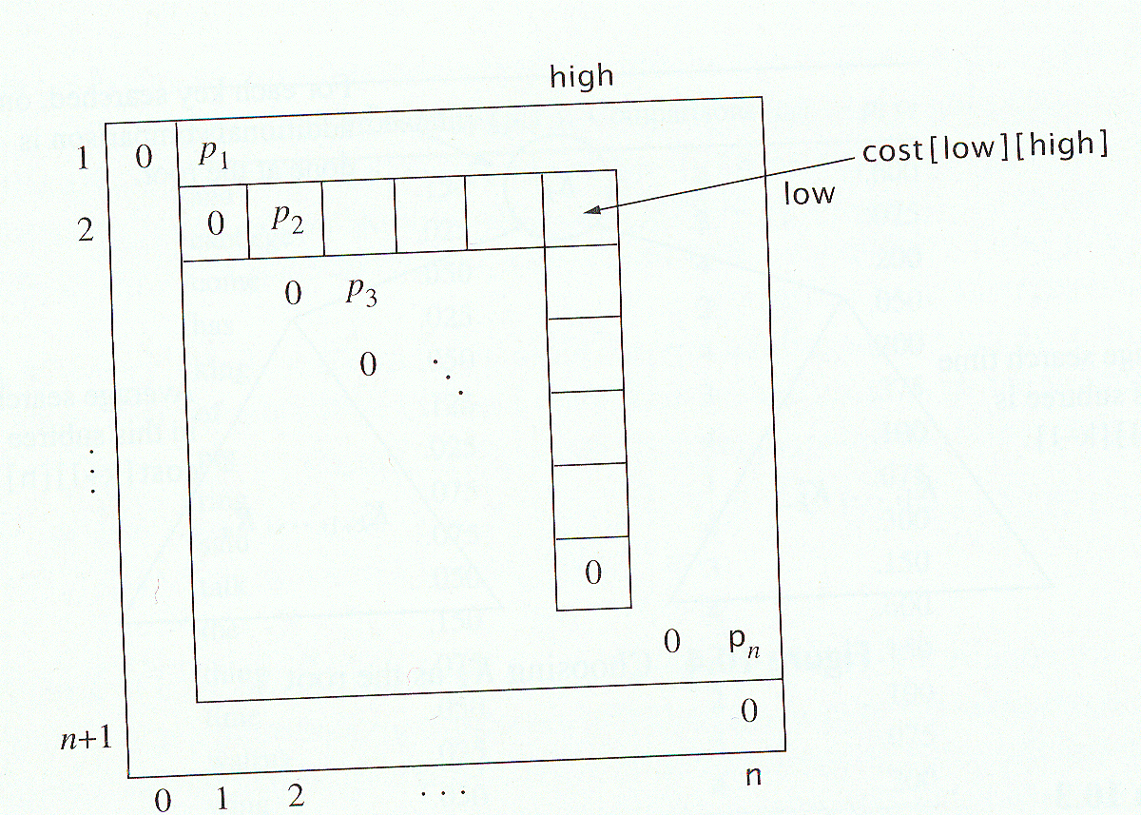
Filling in the Cost Matrix
We define the following:
  A(low, high, r) =
    minimum cost for nodes low..high already added to the tree where node r is the root
  A(low, high) =
    min A(low, high, r) for all low <= r <= high
  We also define P(low, high) = pr_{low} + … + pr_{high}
  Now we redefine A(low, high, r) =
    pr_{r} + P(low, r-1) + A(low, r-1) + P(r+1, high) + A(r+1, high) =
    P(low, high) + A(low, r-1) + A(r+1, high)
Our DP solution will slowly fill in a cost matrix equivalent to A(low, high, r) for each r, building up from low = n and high = low-1 down to low = 1 and high = 1

Slide 15
Optimal Binary Search Tree Algorithm
OptimalBST(pr, n, cost, root)
for(low = n+1; low > 0; low--)
for(high=low-1;high<=n;high++)
bestChoice(pr, cost, root, low, high)
bestChoice(pr, cost, root, low, high)
if(high < low)
bestCost = 0
bestRoot = -1
else
bestCost = infinity
for(r=low;r<=high;r++)
rCost = p(low, high) +
cost[low][r-1] + cost[r+1][high]
if(rCost < bestCost)
bestCost=rCost
bestRoot=r
cost[low][high] = bestCost
root[low][high] = bestRoot
This algorithm slowly builds up the matrices of cost and root
  Cost stores the cost of each tree given nodes low..high
  Root stores the root of each subtree as we build up cost
p is a function that determines pr[low] + … + pr[high] and returns this value
  The algorithm as is is in θ(n⁴)
  We can improve this by making p remember each pr[i] + … + pr[j] sequence so that we slowly build these up reducing p to θ(1) and reducing the whole algorithm to θ(n³), a vast improvement over θ(n!) from the DFS version

Slide 16
Line Breaking
A common problem for word processors is where to insert a line break
  Consider a text file where the width of any given line is limited to W characters
    A greedy solution starts counting at 0 and increments for each character added to the line until the number of characters on the line + nextword > W in which case the next word is put on the next line
      Unfortunately, this is not a good solution because it might leave text poorly spaced
    A DP solution will improve the performance without adding much cost to the complexity
    As an example, consider the text:
      Those who cannot remember the past are condemned to repeat it.
      There are 11 words with spacing as follows [6, 4, 7, 9, 4, 5, 4, 10, 3, 7, 4]
      Note that a word’s spacing equals the number of characters in the word (including punctuation) + 1 extra for a blank space after the word

Slide 17
Greedy Solution and Penalty
The greedy algorithm is given to the right
It should be obvious that its complexity is θ(n) where n is the number of words in the text
  If we use the previous text with a width W = 17 and a penalty of (W – textsize)³, this solution gives us the text to the right with a penalty of 640
    Note: we do not penalize the last line of a paragraph
    The optimal version has a penalty of 472
words_in_line is a string array
initialized to null
line = 0
while (more words in text)
space = 0
next ← next word in text
while (space + size of next < W)
words_in_line[line] += next
space += size of next
line++
for(j=0;j<line;j++)
output(words_in_line[j] + “\n”)
Example using Greedy Algorithm:
Those who cannot [0 spaces, penalty = 0]
remember the [4 spaces, penalty = 64]
past are [8 spaces, penalty = 512]
condemned to [4 spaces, penalty = 64]
repeat it. [6 spaces, penalty = 0]

Slide 18
DP Solution
A skeleton of the DP solution is given on page 474
  The strategy is to build up possible text sequences by combining at first pairs of words and then adding a word to each pair, etc
    For instance, combining words 2 and 3 leaves 6 spaces, penalty of 216
      We do similarly for all other pairs of words
    Now, we try to build on this
      Can we add 1 to 2/3? Yes, it leaves 0 spaces, penalty of 0
      Can we add 4 to 2/3? No, too big
      We do similarly for all other pairs of words
    We continue to build until all of our groups are as large as they can be
      We now go through and select the grouping that provides the minimum penalty
        The dictionary starts with individual words and each array row builds upon the previous row
    The complexity of the DP algorithm is θ(W* n) where W is the limit on line size (this worst case assumes all words could be single character words) and since W is a constant, we have a complexity of θ(n)

